Slide 1


Fermalogis Inc. Survival Analysis On Employee Attrition
OPIM 5894
Survival Analysis Project
Professor Niam Yaraghi

Slide 2
Contents
Our Team
Project Overview
Data Preprocessing
Data Exploration
Data Visualization
Solutions & Recommendations
Business Case
Data Insights
Factors for Consideration
Survival Analysis Results

Slide 3
Our Team
Manishi Kumari
Kumari Juhi
Arpita Ghosh
Sourav Sethia

Slide 4
Project Overview
Fermalogis Inc - Pharmaceutical Company led by CEO Larry Hansen.
The Company is facing high attrition rate due to the exit of experienced employees.
COO plans to invest in data science to deep dive into the data for insights on attrition.
The external company doing the analysis on data uses Survival Analysis Techniques.
The data used are “FermaLogis_Event_Type.csv” & “Data_dictionary.txt”.
Tool used for knowing the trends is SAS
Plotting of data using various SAS Functions and Tableau Visualizations are explored to know the reason behind attrition
Business solutions and recommendations given

Slide 5
Business Case
Fermalogis Inc faces exits of employees once they attain skills which are most in demand
Company plans to bring down attrition rate by bringing various reforms within an Organization
The COO plans to identify key metrics within its organization that leads to higher attrition
Plans to hire an Analytics Company expert in determining the survival analysis patterns of Employees
Develop a report which will help the company to analyse the trend that can help them to bring down the attrition rate
Low attrition rate will help the company to focus on future expansion and growth

Slide 6
Data Description
Key Attribute Details
Features | Description
Business Travel | describes if the employee had opportunity to travel
Environment Satisfaction | Rates the level of work environment satisfaction
Department | States the department in which the employee works
Education | The highest education degree of the employee in the organization
OverTime | Employee works overtime or not
YearsAtCompany | Number of years at FermaLogis
Employee data used - “FermaLogis_Event_Type.csv” & Data Dictionary used - “data_dictionary.txt”.
Initial data consists of 76 variables and 1470 Observations.
New Variable i.e. “Turnover Type” is created.
Different Turnover Types used are:
0 - No turnover
1 – Retirement
2 - Voluntary Resignation
3 - Involuntary Resignation (Health problems, family matters etc.)
4 - Job Termination, Employee is Fired.

Slide 7
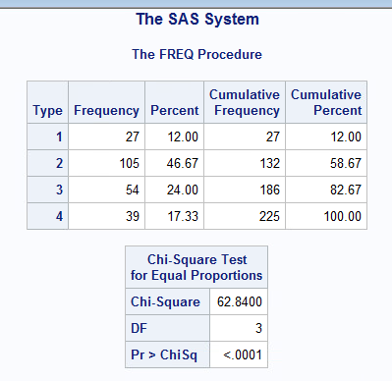
Data Exploration
It is one of the key steps in data analysis and typically involves unstructured way to draw initial patterns, characteristics, and points of interest.
1. Frequency distribution of Event Type

Slide 8
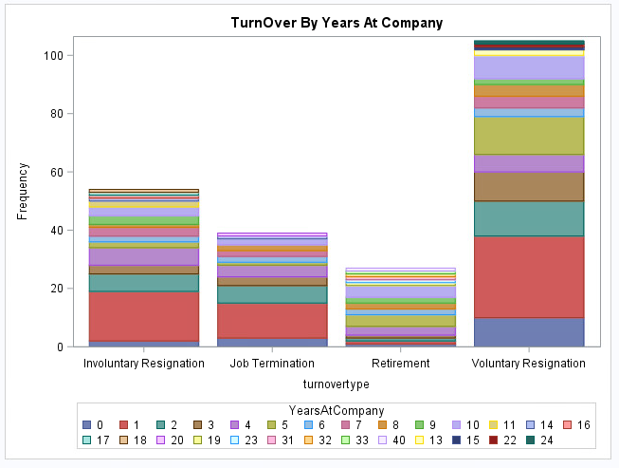
Distribution of Turnover with Years at Company
It can be observed from the plot that employees who are there in the company for less than 5 years are more likely to leave the company than any other employees but the employees who are there with the company for 1-year are the ones whose attrition rate is highest

Slide 9
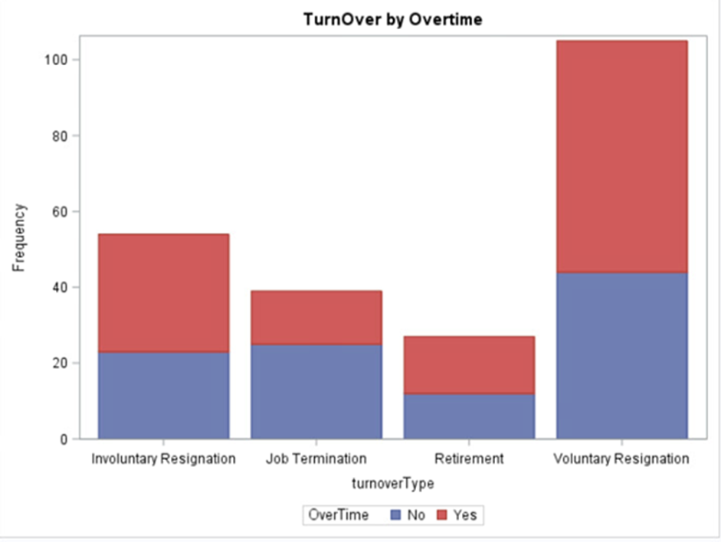
Distribution of Turnover with OverTime
It can be observed from the plot that the employees who work overtime are more likely to go for Voluntary Resignation

Slide 10
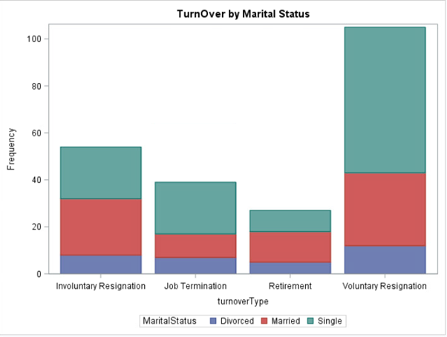
Distribution of Turnover with Marital Status
It can be observed from the above plot that the employees whose marital status is single are more likely to go for Voluntary Resignation

Slide 11
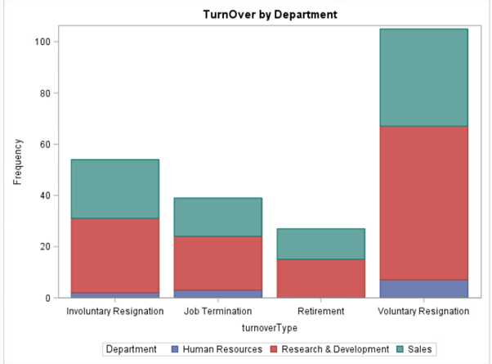
Distribution of Turnover with Overtime
It can be observed from the above plot that the employees who work with Research & Development department are more likely to go for Voluntary Resignation

Slide 12
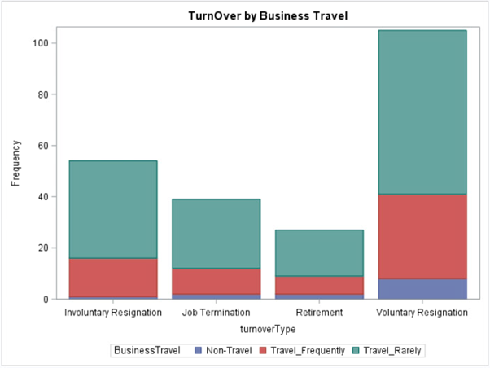
Distribution of Turnover with Business Travel
The relation between the variable turnover types and Business Travel indicates that the employees who travel frequently are more likely to leave the company

Slide 13
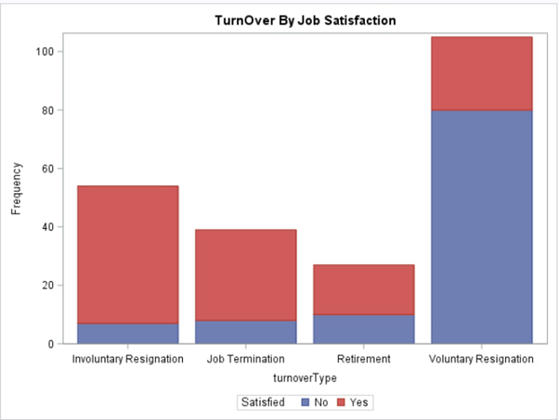
Distribution of Turnover with Job Satisfaction
It can be observed from the above plot that the employees who are not satisfied with their job profiles are more likely to go for Voluntary Resignation

Slide 14
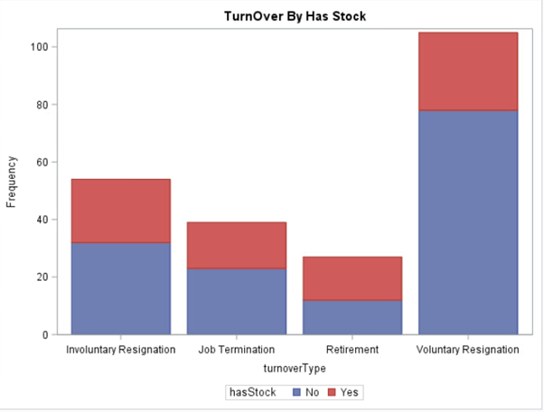
Distribution of Turnover with Stock Options
It can be observed from the above plot that the employees who has no stock are more likely to go for Voluntary Resignation

Slide 15
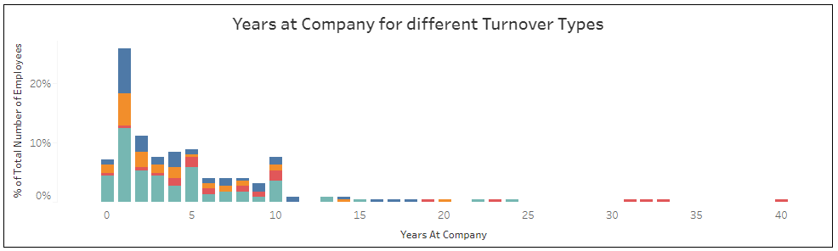
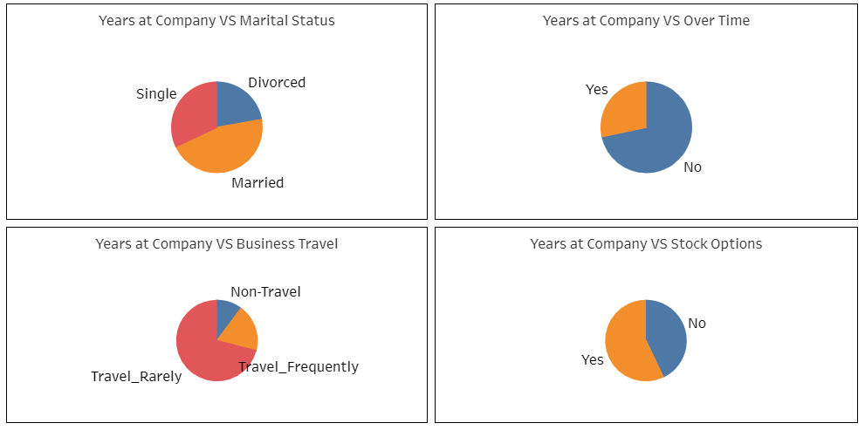
Tableau Visualization
Link for Tableau Public
https://public.tableau.com/profile/sourav.sethia#!/vizhome/FermalogicIncAttritionData/AttritionAnalysis

Slide 16
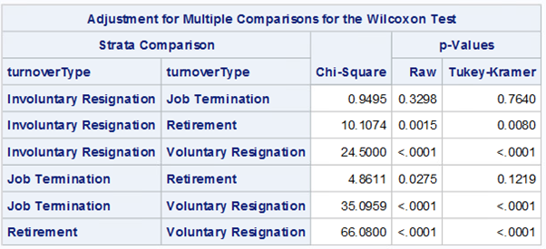
Survival Analysis Results
Strata Comparison Table/ p-value comparison between different event type
Log-Log Survival plot (LLS) is used for checking the linearity
LLS is used for Weibull distribution which helps in interpreting the shape of the hazard function
All other combinations of turnover types is statistically significant based on p-value except Involuntary Resignation and Job Termination

Slide 17
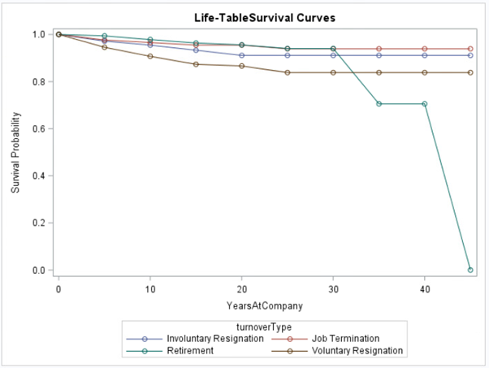
Survival estimate plot for all TurnOver Type
Survival Analysis Results
Survival estimate plot has been made which shows that number of employees who are resigning involuntarily is linearly proportional to those who are terminated. Hence, these two event types can be clubbed together

Slide 18
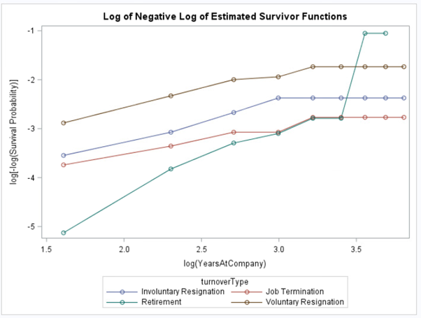
LLS plot of all event types
Survival Analysis Results
LLS graph of all event types plotted above shows that the ω values for Involuntary and Terminated employees are almost same
To check the possibility of using both event types together, PHREG model for each event types separately and combined are built

Slide 19
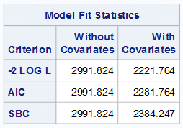
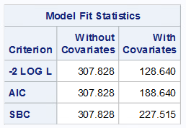
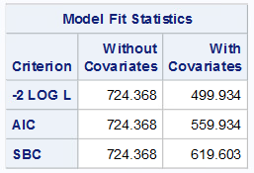
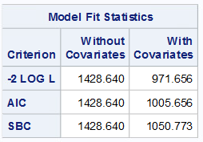
Modelling using PHREG
Nested and Individual event type
Nested event type
Retirement Event
Involuntary Resignation
Voluntary Resignation

Slide 20

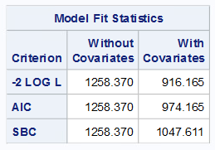
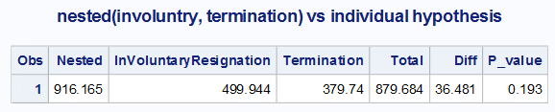
Total nested vs individual hypothesis
Modelling using PHREG
P-value for nested vs individual models is significant, hence, separate models need to be created
Nested model (Involuntary resignation + Job Termination)
Nested (Involuntary resignation + Job Termination) vs individual hypothesis
P-value for nested vs individual models (involuntary resignation + Job termination) is insignificant, hence, nested model can be created for these event types

Slide 21
COX Proportional Hazards Modelling Technique
This model enables to know the hazard ratio between two groups considering the covariates
It doesn’t require to know the distribution before-hand, it can be used for calculating the hazard ratio of Turnover to No Turnover employees
Assumptions for the Model
Four types of turnovers have been considered – Retirement, Voluntary Resignation, Involuntary Resignation and Termination
Separate models have been built for all the four types of event
Separate models have shown better performance as well as helped in explaining different turnover types as compared to nested model

Slide 22
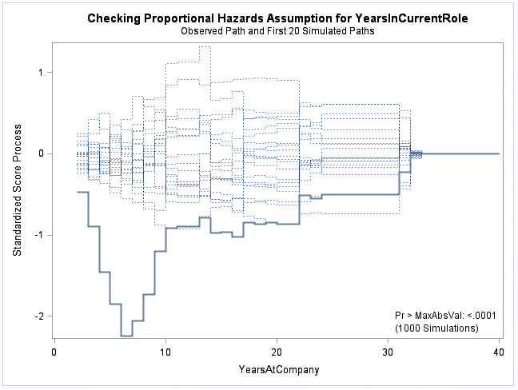
Proportional Hazard Assumption for Years in Current Role
The Proportional Hazard graph shows a thick blue line for Years In Current Role variable heavily deviating from the simulations having significant p-value. Hence, this is a time-dependent covariate
Years in current role is a time-dependent covariate based on the above graph, it means that years in current role is dependent on the Years At Company

Slide 23
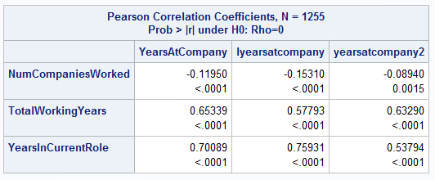
Schoenfeld Residuals
This is another way of testing the non-proportionality of the covariates
It tests the independence between residuals and time
This test has been used in the analysis to check if the residuals of significant covariates are correlated to employee’s tenure with the company
As shown from the Pearson Correlation Coefficients, Number of companies worked, Total Working Years and Years in Current Role have significant p-value. Hence, they are significant covariates

Slide 24
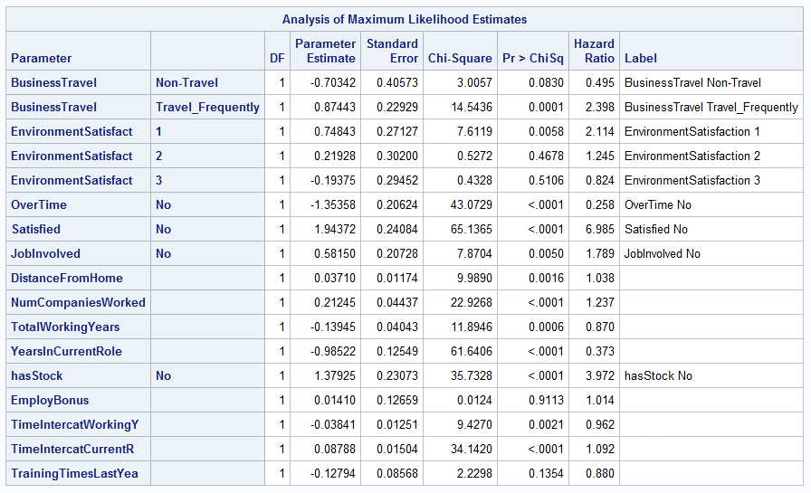
Voluntary Resignation Model Results
As shown in the table, p-values are significant for 8 variables of interest. For example, employees who travel frequently are more likely to leave the company as compared to employees who travel rarely

Slide 25
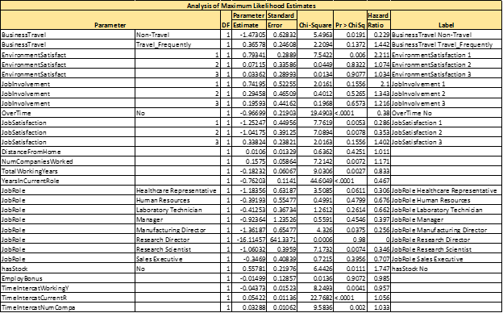
Involuntary Resignation Model Results
As shown in the table, p-values are significant for 5 variables of interest. For example, employees who work overtime are more likely to leave the company as compared to non-overtime working companies

Slide 26
Conclusion
Frequency of each individual TurnOver type is significantly different from one another in terms of attrition rate hence, each TurnOver type is different
Linearity between TurnOver Types could be observed from LLS plot in Figure 15, where Involuntary resignation and Job Termination are linearly related. Same point could be concluded from Proportional hazard plot in Figure 20 and Wilcoxon test in Figure 13 as well
P-value for combination of Involuntary Resignation and Job Termination is 0.193 which is not significant, hence nested model would be best
For Retirement – Age, Job Involvement, Business Travel, Bonus and Interaction Variable Years in current role are significant variables
For Voluntary Resignation- has Stocks, Business Travel, Environment Satisfaction, Job satisfaction, Job Involvement, interaction term - number of companies worked and Years in current role are significant variables
Employee Bonus has a significant impact on employees who are retiring from the company but has no significant impact on the other event types
NumCompanies Worked, Total Working Years and Years In Current Role are the non-proportional variables with respect to hazard

Slide 27
Recommendations
Management could reduce overtime of the employees by hiring few temporary employees and shifting the extra work
Management should try reducing the Business travel associated with any employee by hiring new employees at required location, train other employees on the same skill set to reduce dependency on any employee, give some incentive to those employees who travel frequently
There is a strong impact of hasStocks on employee turnover, so Management should promote or give additional benefits or lucrative offers like issuing stocks at subsidized rates with higher returns on investment for in house employees who are interested in buying stock
By motivating employees with good leadership and encouraging them with their work can lead to a better job satisfaction and involvement levels. This might reduce the turnover rate associated with these factors
Environment satisfaction is one of the major factors of attrition, so Management can arrange for some Fun events or Family events in every quarter to boost up the momentum and productivity of the employees

Slide 28
References
https://www.sas.com/storefront/aux/en/splsb/65423_excerpt.pdf
https://newonlinecourses.science.psu.edu/stat507/node/81/
https://stats.idre.ucla.edu/sas/seminars/sas-survival/

